Slide 1
CS 110 - Professional Practices in IT Instructor Name : Dr Tariq Umer Email : tariqumer@cuilahore.edu.pk

Slide 2
WEEK -3 Professional Code of Ethics

Slide 3
Topics Covered in this Lecture
Understanding Professional Code of Ethics
Professional Responsibilities of IT Persons
ACM code of Ethics

Slide 4
Learning outcomes of this Lecture
To understand the Professional Ethical Responsibilities
Learning ACM Code of Ethics.
To know different types of Ethical challenges in new era.
How to manage personal Ethics in IT Profession

Slide 5
Professional Code of Ethics
states the principles and core values that are essential to the work of a particular occupational group.
Practitioners in many professions subscribe to a code of ethics that governs their behavior.
Most codes of ethics include:
What the organization aspires to become
Rules and principles by which members of the organization are expected to abide
No universal code of ethics for IT professionals
No single, formal organization of IT professionals has emerged as preeminent

Slide 6
Why Professional Code of Ethics?
Following a professional code of ethics can produce many benefits for the individual, the profession, and society as a whole. It helps in:
Ethical decision making
High standards of practice and ethical behavior
Trust and respect from general public
Evaluation benchmark for self-assessment

Slide 7
Professional Organizations
Five of the most prominent IT-related professional organizations are:
Association for Computing Machinery (ACM)
Association of IT Professionals (AITP)
Institute of Electrical and Electronics Engineers Computer Society (IEEE-CS)
Project Management Institute (PMI)
SysAdmin, Audit, Network, Security (SANS) Institute

Slide 8
Certifications
Indicates that a professional possesses a particular set of skills, knowledge, or abilities in the opinion of a certifying organization
Can be applied to people as well as products (the Wi-Fi CERTIFIED logo assures that the product has met rigorous interoperability testing to ensure that it will work with other Wi-Fi-certified products)
Generally voluntary
Employers view as benchmark of knowledge
Opinions are divided on value of certification
Two types:
Vendor certifications
Industry association certifications

Slide 9
Vendor certifications
Cisco, IBM, Microsoft, Sun, SAP, and Oracle
Some certifications substantially improve IT workers’ salaries and career prospects
Relevant for narrowly defined roles or certain aspects of broader roles
Require passing a written/practical exam
Can take years to obtain experience
Training can be expensive
Workers are commonly recertified as newer technologies become available

Slide 10
Industry association certifications
Require a higher level of experience and a broader perspective than vendor certifications
Lag in developing tests that cover new technologies
Are moving from purely technical content to a broader mix of technical, business, and behavioral competencies
NET+, CompTIA Network+, TIA Certified, A+, Certified Information Systems Auditor (CISA), Certified Information Systems, Security Professional (CISSP), Global Information Assurance Certification (GIAC)

Slide 11
Government License
A government-issued permission to engage in an activity or to operate a business.
It is generally administered at the state level and often requires that the recipient pass a test of some kind.
Issues with government licensing of IT workers
No universally accepted core body of knowledge
Unclear who should manage content and administration of licensing exams
No administrative body to accredit professional education programs
No administrative body to assess and ensure competence of individual workers

Slide 12
IT Professional Malpractice
Negligence: not doing something that a reasonable person would do, or doing something that a reasonable person would not do
Duty of care: obligation to protect people against any unreasonable harm or risk
Professional malpractice: professionals who breach the duty of care (the failure to act as a reasonable person would act) are liable for injuries that their negligence causes

Slide 13
Common Ethical Issues for IT Users
Software piracy
Inappropriate use of computing resources
Erodes productivity and wastes time
Could lead to lawsuits
Inappropriate sharing of information, including:
Private data (employees and customers)
Confidential information (company and operations)

Slide 14
Software engineering code of ethics
HISTORY
IEEE Board of Governors established steering committee (May, 1993).
ACM Council endorsed Commission on Software Engineering (Late 1993).
Joint steering committee established by both societies (January, 1994).

Slide 15
Research
Review of available computing and engineering codes:
The American Association of Engineering Societies
Accreditation Board for Engineering Technology
ACM’s Code of Ethics for Professional Conduct
The British Computer Society Code of Practice
Institute for the Certification of Computing Professionals
Engineer’s Council for Professional Development
The IEEE Code of Ethics
National Society of Professional Engineers Code of Ethics
Project Management Institute Code of Ethics

Slide 16
Brief History Timeline
January 1994 - International Task Force formed the Software Engineering Ethics and Professional Practice (SEEPP).
July 1997 - Initial version shown to professional societies including ACM
November 1997 - Version 3 published in IEEE-CS and ACM magazines.
Version 4 presented to IEEE review process.
October 1998 - Version 5.2 universally adopted by ACM and IEEE.

Slide 17
8 Key Principles:
Product
Public
Judgement
Client and Employer
Management
Profession
Colleagues
Self

Slide 18
Principle 1: Products
1.01 Ensure adequate software specification
1.02 Understand specifications fully
1.03 Ensure you are suitably qualified
1.04 Ensure all goals are achievable
1.05 Ensure proper methodology use
1.06 Ensure good project management
1.07 Ensure all estimates are realistic
1.08 Ensure adequate documentation
1.09 Ensure adequate testing and debugging
1.10 Promote privacy of individuals
1.11 Use data legitimately
1.12 Delete outdated and flawed data
1.13 Identify and address contentious issues
1.14 Promote maximum quality and minimum cost
1.15 Follow appropriate industry standards

Slide 19
Principle 2: Public
2.01 Disclose any software-related dangers
2.02 Approve only safe, well tested software
2.03 Only sign documents in area of competence
2.04 Cooperate on matters of public concern
2.05 Produce software that respects diversity
2.06 Be fair and truthful in all matters
2.07 Always put the public’s interests first
2.08 Donate professional skills to good causes
2.10 Accept responsibility for your own work

Slide 20
Principle 3: Judgement
3.01 Maintain professional objectivity
3.02 Only sign documents within your responsibility
3.03 Reject bribery
3.04 Do not accept secret payments from the client
3.05 Accept payment from only one source for a job
3.06 Disclose conflicts of interest
3.07 Avoid conflicting financial interests
3.08 Temper technology judgments with ethics

Slide 21
Principle 4: Client and Employer
4.01 Provide services only where competent
4.02 Ensure resources are authentically approved
4.03 Only use property as authorized by the owner
4.04 Do not use illegally obtained software
4.05 Honor confidentiality of information
4.06 Raise matters of social concern
4.07 Inform when a project becomes problematic
4.08 Accept no detrimental outside work
4.09 Represent no interests adverse to your employer

Slide 22
Principle 5: Management
5.01 Assure standards are known by employees
5.02 Assure knowledge of confidentiality protocols
5.03 Assign work according to competence
5.04 Provide due process for code violations
5.05 Develop fair ownership agreements
5.06 Accurately describe conditions of employment
5.07 Offer only fair and just remuneration
5.08 Do not prevent a subordinate’s promotion
5.09 Do not ask a person to breach this code

Slide 23
Principle 6: Profession
6.01 Associate with reputable people
6.02 Promote commitment of this code
6.03 Support followers of this code
6.04 Help develop an ethical environment
6.05 Report suspected violations of this code
6.06 Take responsibility for errors
6.07 Only accept appropriate remuneration
6.08 Be accurate and honest regarding software
6.09 Place professional interests before personal
6.10 Obey all laws governing your work
6.11 Exercise professional responsibility
6.12 Promote public knowledge of the subject
6.13 Share software knowledge with the profession

Slide 24
Principle 7: Colleagues
7.01 Assist colleagues in professional development
7.02 Review other’s work only with their consent
7.03 Credit fully the work of others
7.04 Review others work candidly
7.05 Give fair hearing to colleagues
7.06 Assist colleagues’ awareness of work practices
7.08 Do not hinder a colleague’s career
7.09 Do not pursue a job offered to a colleague
7.10 Seek help with work outside your competence

Slide 25
Principle 8: Self
8.01 Further your own professional knowledge
8.02 Improve your ability to produce quality work
8.03 Improve your ability to document work
8.04 Improve your understanding of work details
8.05 Improve your knowledge of relevant legislation
8.06 Improve your knowledge of this code
8.07 Do not force anyone to violate this code
8.08 Consider code violations inconsistent with software engineering

Slide 26
The Code Adoption Published
“Software Engineering Code of Ethics is Approved”
by Gotterbarn, Miller, and Rogerson
(October 1999/Vol. 42, No. 10, Communication of the ACM)

Slide 27
Short version, 1 of 2
1. PUBLIC - Software engineers shall act consistently with the public interest.
2. CLIENT AND EMPLOYER - Software engineers shall act in a manner that is in the best interests of their client and employer, consistent with the public interest.
3. PRODUCT - Software engineers shall ensure that their products and related modifications meet the highest professional standards possible.
4 . JUDGMENT - Software engineers shall maintain integrity and independence in their professional judgment.

Slide 28
Short version, 2 of 2
5. MANAGEMENT - Software engineering managers and leaders shall subscribe to and promote an ethical approach to the management of software development and maintenance.
6. PROFESSION - Software engineers shall advance the integrity and reputation of the profession consistent with the public interest.
7. COLLEAGUES - Software engineers shall be fair to and supportive of their colleagues.
8. SELF - Software engineers shall participate in lifelong learning regarding the practice of their profession and shall promote an ethical approach to the practice of the profession.

Slide 29
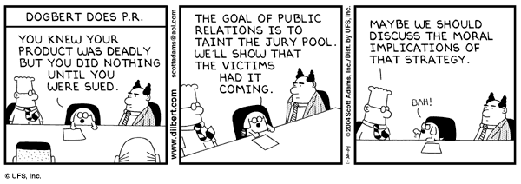
Public
1.04. Disclose to appropriate persons or authorities any actual or potential danger to the user, the public, or the environment, that they reasonably believe to be associated with software or related documents.

Slide 30
ACM Code of Ethics
1 | General Ethical Principles
Contribute to society and to human well-being, acknowledging that all people are stakeholders in computing.
Avoid harm.
Be honest and trustworthy.
Be fair and take action not to discriminate.
Respect the work required to produce new ideas, inventions, creative works, and computing artifacts.
Respect privacy.
Honor confidentiality.

Slide 31
2 | Professional Responsibilities
Strive to achieve high quality in both the processes and products of professional work.
Maintain high standards of professional competence, conduct, and ethical practice.
Know and respect existing rules pertaining to professional work.
Accept and provide appropriate professional review.
Give comprehensive and thorough evaluations of computer systems and their impacts, including analysis of possible risks.
Perform work only in areas of competence.
Foster public awareness and understanding of computing, related technologies, and their consequences.
Access computing and communication resources only when authorized or when compelled by the public good.
Design and implement systems that are robustly and usably secure.

Slide 32
3 | Professional Leadership Principles
Ensure that the public good is the central concern during all professional computing work.
Articulate, encourage acceptance of, and evaluate fulfillment of social responsibilities by members of the organization or group.
Manage personnel and resources to enhance the quality of working life.
Articulate, apply, and support policies and processes that reflect the principles of the Code.
Create opportunities for members of the organization or group to grow as professionals.
Use care when modifying or retiring systems.
Recognize and take special care of systems that become integrated into the infrastructure of society.

Slide 33
4 | Compliance with the Code
Uphold, promote, and respect the principles of the Code.
Treat violations of the Code as inconsistent with membership in the ACM.

Slide 34
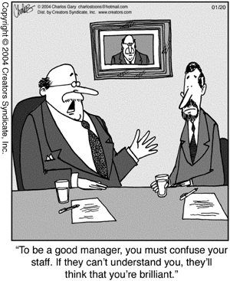
Management
5.01 Ensure good management for any project on which they work, including effective procedures for promotion of quality and reduction of risk.

Slide 35
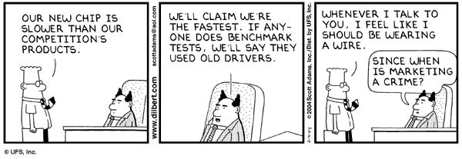
Profession
6.07. Be accurate in stating the characteristics of software on which they work, avoiding not only false claims but also claims that might reasonably be speculative, vacuous, deceptive, misleading, or doubtful.

Slide 36
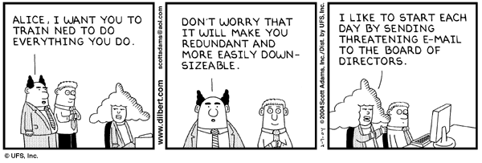
Colleagues
7.02. Assist colleagues in professional development.

Slide 37
Assignments
Individual Assignment # 1
What kind of ethical issues related to IT we are facing today? List at least 5 different issues with real life examples. You can Search the Web/newspapers for real life stories.
Group Assignment # 1: (2 members)
Select one software house / IT based organization. Find out what Ethical/Professional code of conduct they have implemented. Submit short report on it.

Slide 38
End of Lecture

